Slide 1


Geethanjali College of Engineering and Technology Department of CSE- Data Science
A Project on:
URBAN TREE HEALTH
MONITORING
Monitoring urban tree health across multiple cities using NDVI technology.
PRESENTED BY: G.Harshith
1

Slide 2

OVERVIEW OF KEY TOPICs
Explore urban tree health monitoring through NDVI technology
Problem Statement and Importance Project Goals and Objectives
Tools and Technologies Used Explanation of NDVI Functionality Application Workflow Overview
URBAN TREE HEALTH MONITORING

Slide 3

Problem Statement:
Urban greenery is essential for environmental balance, but tracking its health across large cities is a major challenge.
Why Monitor Urban Tree Health?
Urban trees reduce air pollution and urban heat. Manual monitoring is inefficient and limited in scope.
Solution:
Satellite imagery and NDVI provide a scalable and reliable solution to this problem.
Systematic health monitoring enables early detection of pests, diseases, and environmental stressors

Slide 4
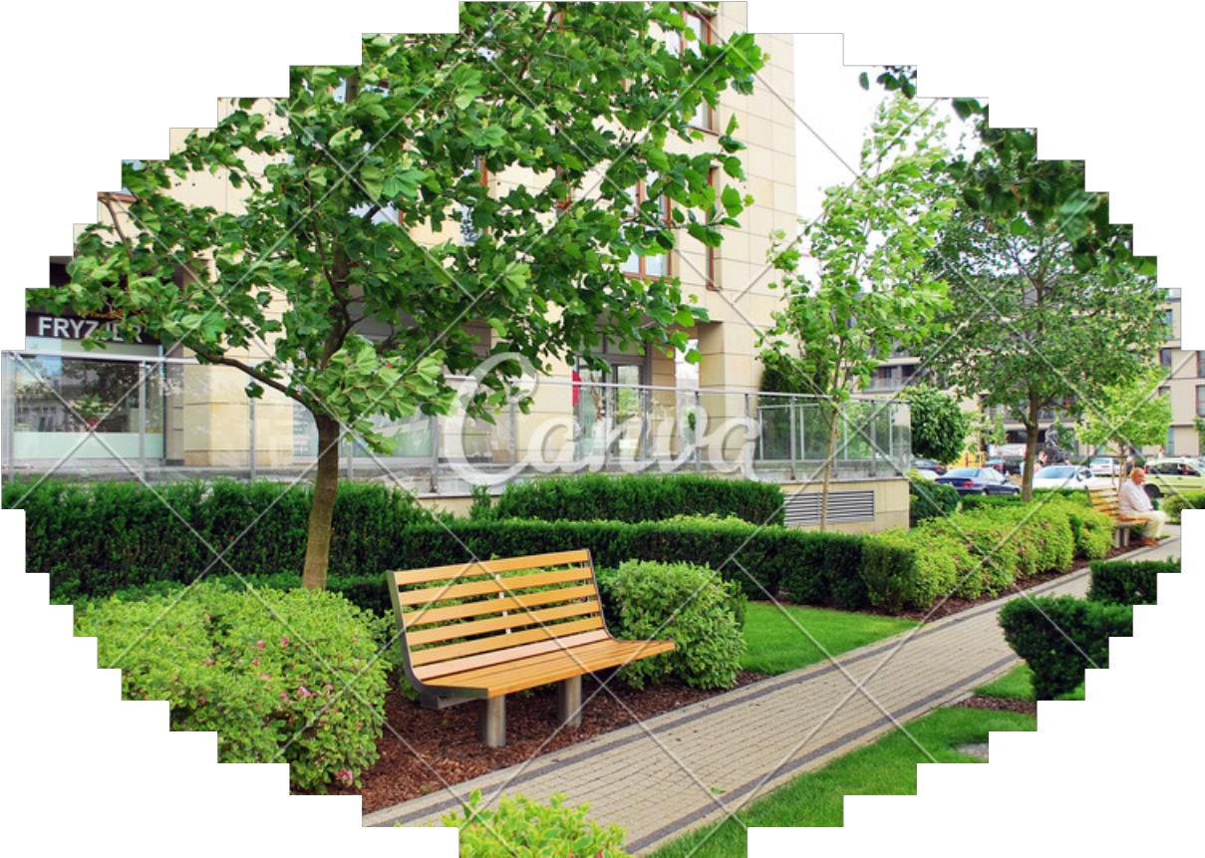
PROjECT GOALs:
Monitor vegetation health using satellite imagery.
Analyze NDVI trends across multiple Indian cities.
Predict future NDVI trends with time series forecasting.
Enable easy comparison and data download options.
Our aim is to empower users — from researchers to city planners — with a tool that allows them to inspect, compare, and predict tree health trends in a simple and visual way.
4

Slide 5
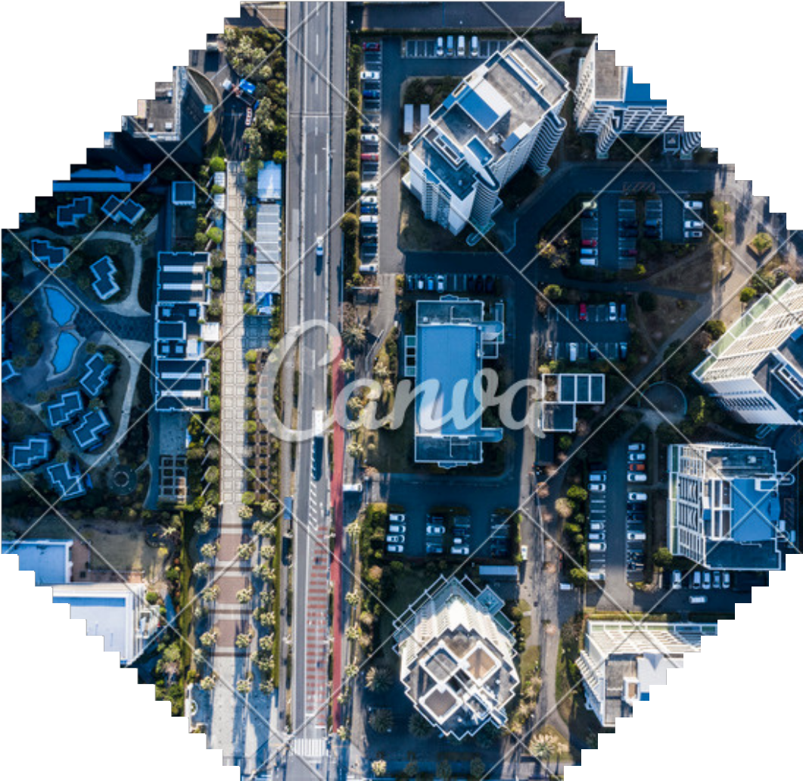
TOOLS & TECHNOLOGIES
Satellite Imagery and GIS Software Utilization:
We utilize high-resolution satellite imagery to assess urban tree health through GIS software for precise mapping and analysis.
NDVI Algorithms for Analysis:
Holt-Winters Exponential Smoothing (Triple Exponential Smoothing)
Purpose: Forecasting future NDVI values based on historical trends.
Tech Stack:
Frontend: Streamlit (Python) Backend: Google Earth Engine Visualization: Plotly, Folium
Forecasting: Holt-Winters Exponential Smoothing
Data Export: CSV & GeoTIFF

Slide 6

Understanding the NDVI formula and its significance
HOW NDVI WORKS
The NDVI formula is essential for assessing vegetation health and density.
NDVI = (NIR - Red) / (NIR + Red)
Values range from -1 to +1 Closer to +1: Healthy vegetation Near 0: Sparse or unhealthy
Importance of NDVI in urban tree health monitoring
NDVI provides critical insights into plant vitality, allowing urban planners to make informed decisions about tree management and sustainability efforts.

Slide 7


APPLICATION WORkFLOW
How It Works:
User selects cities or map points.
App fetches NDVI data from Google Earth Engine.
NDVI is visualized and forecasted.
Users can compare cities and download results.
The app's workflow is straightforward. It integrates user input, satellite data processing, forecasting, and data visualization.
7

Slide 8

KEY FEATUREs
Core Functionalities:
Select predefined or custom cities. View NDVI maps with overlays.
Get NDVI charts with future forecasts. Download CSV & GeoTIFF files.
Assess health: 🌳 Healthy | 🌕 Moderate
| 🌑 Poor
The app is feature-rich: users can add cities from a map, compare vegetation trends, forecast future NDVI values, and download data for offline analysis or reporting.
8

Slide 9
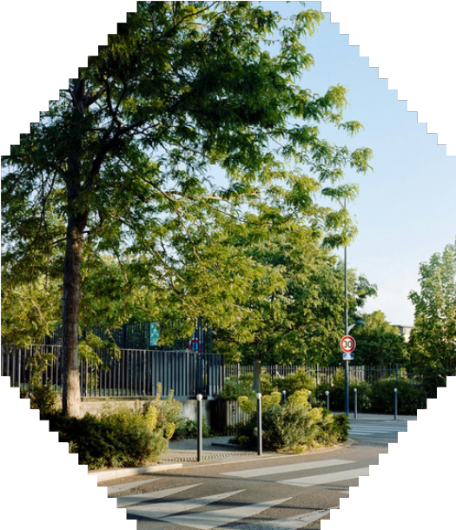

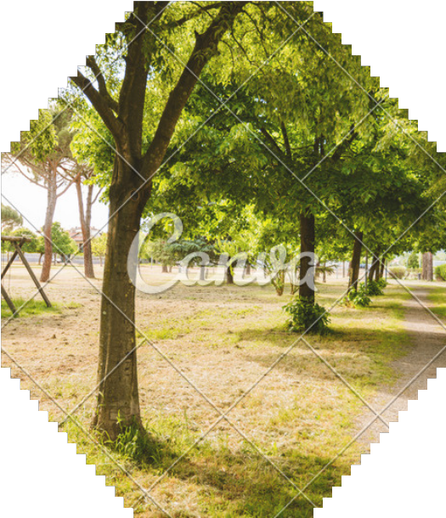
INsIGHTs
Insights from the App:
Cities like Pune & Bhopal showed high NDVI. Delhi & Hyderabad had moderate values.
Forecasts suggest seasonal and urbanization effects. Limited data in some cities due to cloud cover.
>NDVI values revealed interesting patterns. Healthier cities showed consistent values over time, while denser or more polluted areas had weaker vegetation health.
9

Slide 10
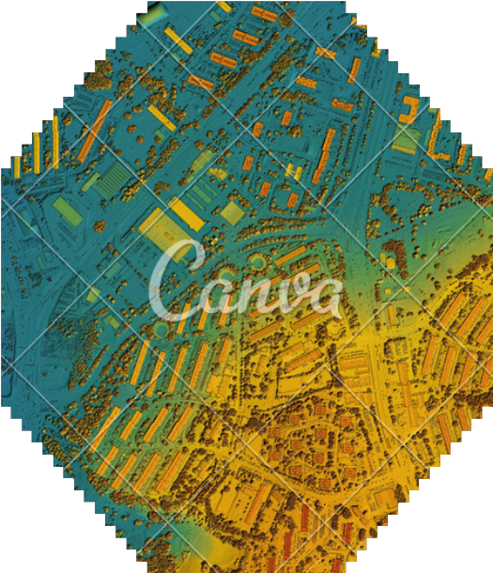

CHALLENGEs IN MONITORING
What We Faced:
Inconsistent satellite data availability. Cloud cover affected image quality.
Some cities returned only one data point.
Fixed using warnings, data checks, and smoothing.
10

Slide 11
CONCLUsION & FUTURE WORk
Final Thoughts:
Successfully created a real-time NDVI analysis tool.
Helps in monitoring urban tree health at scale.
Future ideas: anomaly detection, city rankings, AI generated analysis.
This project proves the feasibility of using satellite data for urban sustainability tracking. With more enhancements, it could serve policymakers, environmentalists, and citizens alike.
11

Slide 12


